Slide 1


Would Kobe Bryant Score?
We love sports!!!
I love machine learning!!!
Team 6:
Alvaro Chinchayan, Leighton Li, Andrey Lifar, Yoki Liu,
Yue Ping, Sherry Zuo

Slide 2


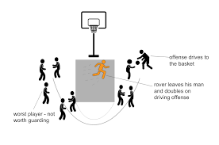
Why did we choose this topic?
A valuable model for basketball players, coaches and sports lovers
Offensive strategies:
E.g. what angle and distance might be better if you want to score
Defensive strategies:
Analyze opponents

Slide 3
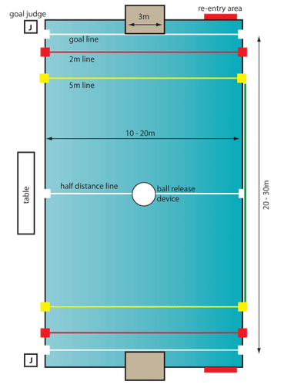
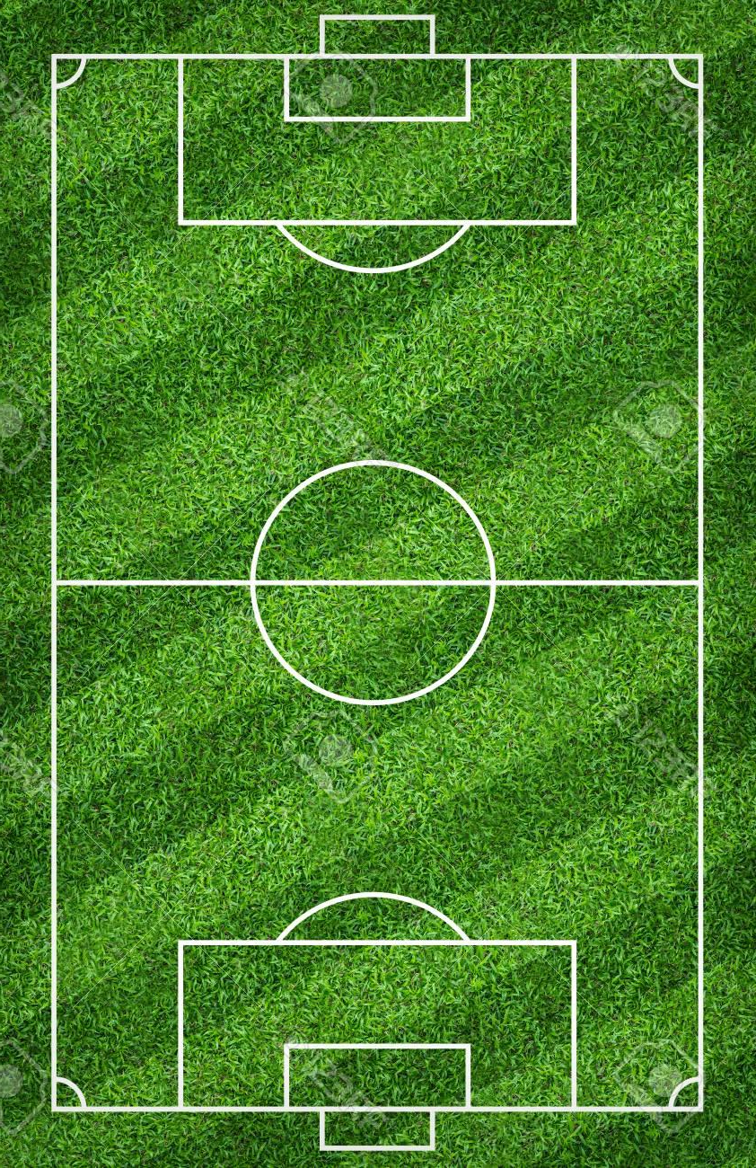
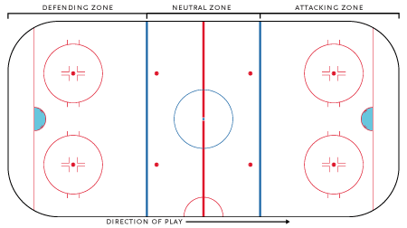
Why did we choose this topic?
Analogy to other sports
Soccer
Ice Hockey
Water Polo

Slide 4
Packages Used
tidyverse
dplyr
tidyr
magrittr
ggplot2
ggthemes
glmnet
lubridate
fastDummies
MASS
rpart
randomForest
rpart.plot
gbm
caret
leaps
ggvis
dvmisc

Slide 5
Dataframes
kobe:(original dataset: https://www.kaggle.com/c/kobe-bryant-shot-selection/data)
30697 rows, 25 columns
Kobe: (NAs removed, more variables added)
25697 rows and 32 columns → 5000 rows deleted
dd: (replaced categorical variables to dummies and remove “id” columns)
25697 rows and 94 columns
dd2: (remove “id” columns, and action_type column)
25697 rows and 14 columns

Slide 6
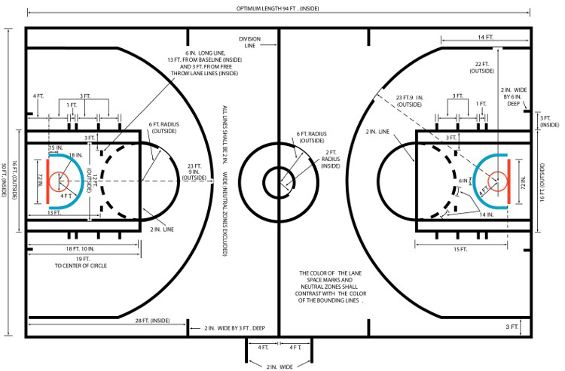
[kobe] Columns (original)
Prediction: shot_made_flag
1.Time:
minutes_remaining
seconds_remaining
time_remaining
2.Location:
lat loc_x loc_y lon
angle angle range
shot_distance shot_zone_area shot_zone_basic shot_zone_range
3.Shot Types:
action_type
combined_shot_type
shot_type
4.IDs:
game_event_id game_id shot_id team_id team_name
5.Games:
period playoffs season game_date
year month day matchup home opponent
atan(abs(loc_y/loc_x))*180/pi
case_when( grepl("@", matchup) ~ 1, grepl("vs.", matchup) ~ 0)

Slide 7
[Kobe] Columns (cont.)
Prediction: shot_made_flag
1.time:
minutes_remaining
seconds_remaining
time_remaining
2.location:
lat lon loc_x loc_y
shot_distance shot_zone_area shot_zone_basic shot_zone_range
angle
angle_range
3.type:
action_type
combined_shot_type
shot_type
4.ID:
game_event_id game_id shot_id team_id team_name
5.game:
Period playoffs
season year month day
game_date matchup opponent
home

Slide 8
[dd] | [dd2] Columns (Final)
Prediction: shot_made_flag
1.time:
time_remaining
2.location:
Loc_x loc_y shot_distance shot_zone_area shot_zone_basic shot_zone_range angle_range
3.types:
combined_shot_type shot_type action_type
4.game:
period playoffs home
Action_type is the detailed version of combined_shot_type

Slide 9
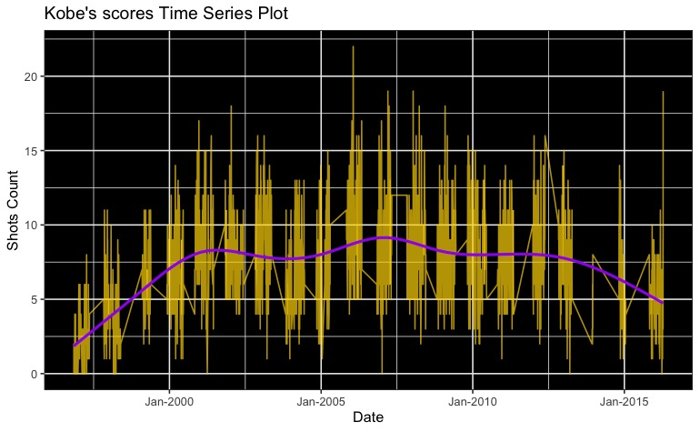
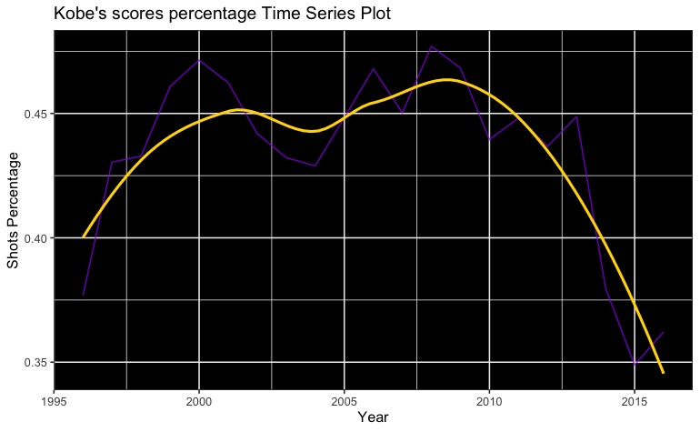
Time Trend

Slide 10
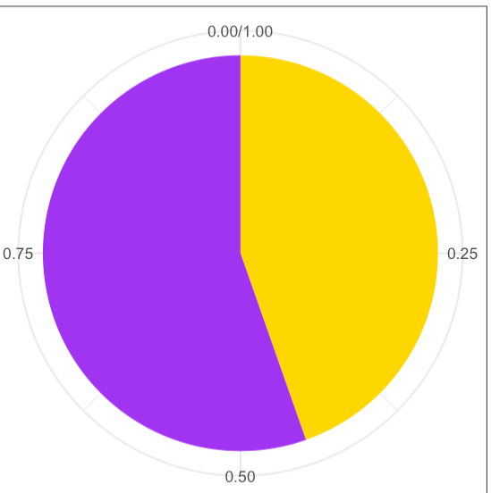
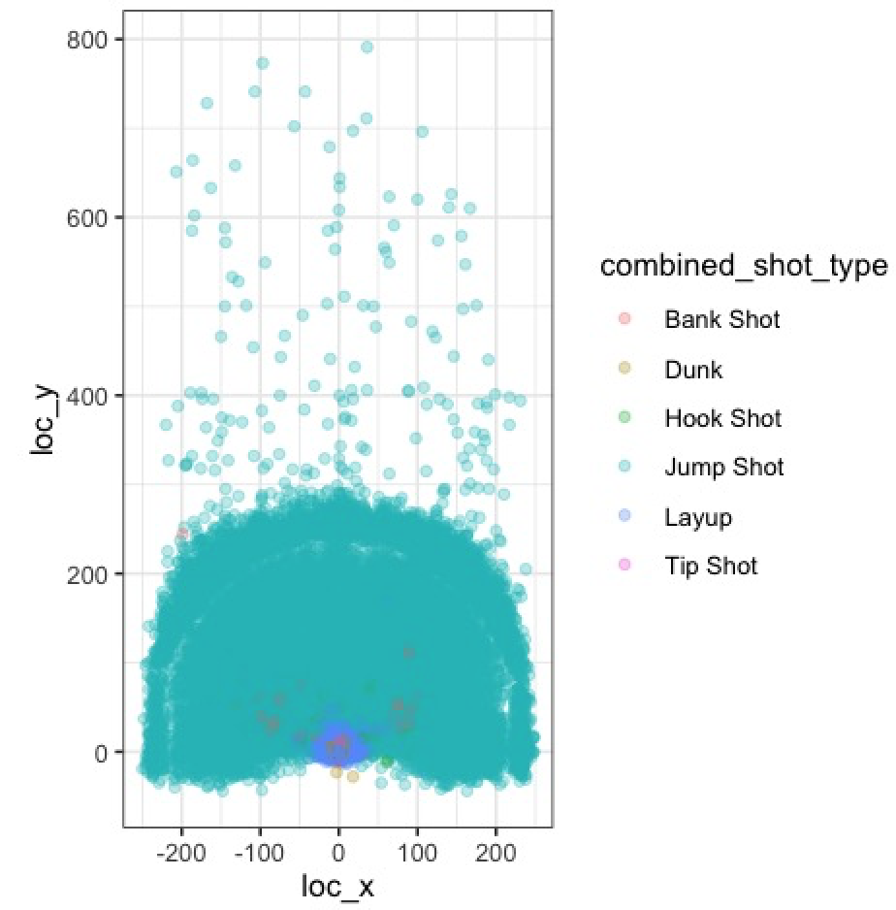
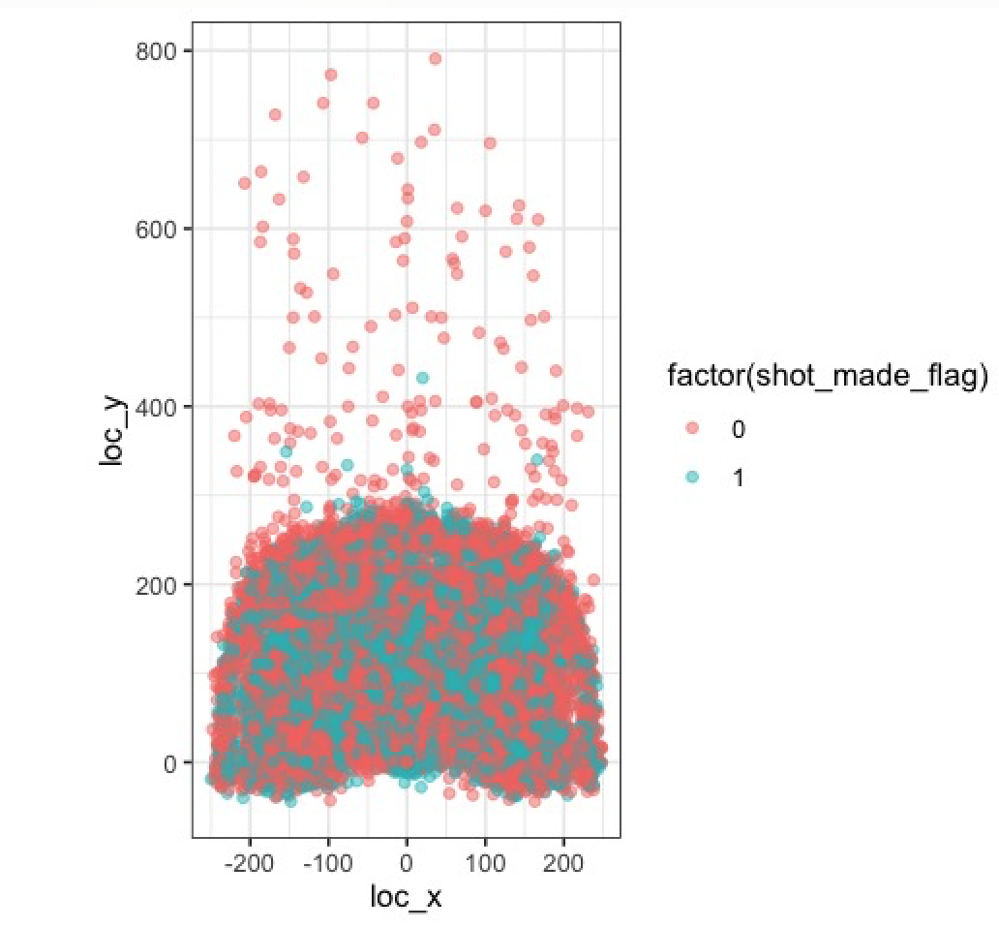
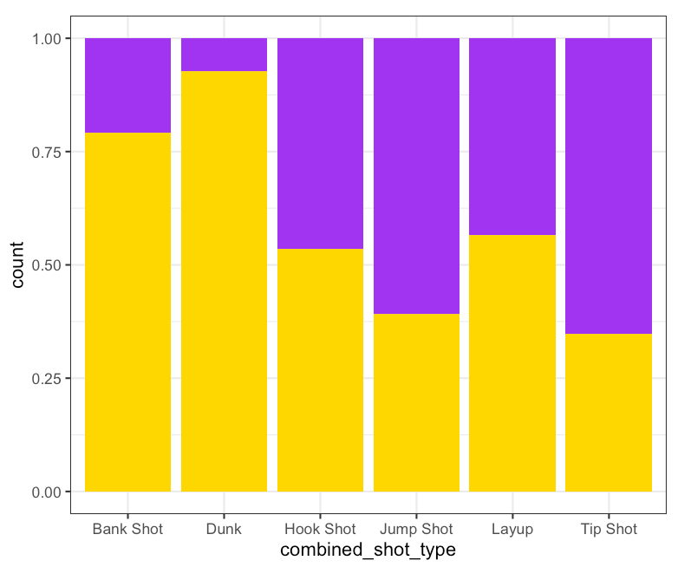
Describing Data - Court Maps
Shot Types
Scored vs. Missed
44.6%

Slide 11
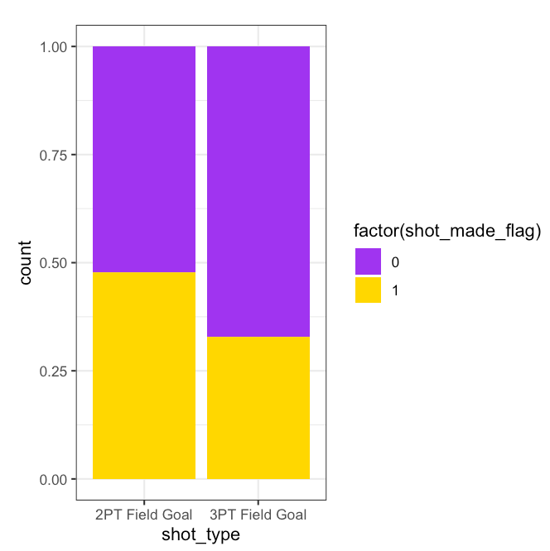
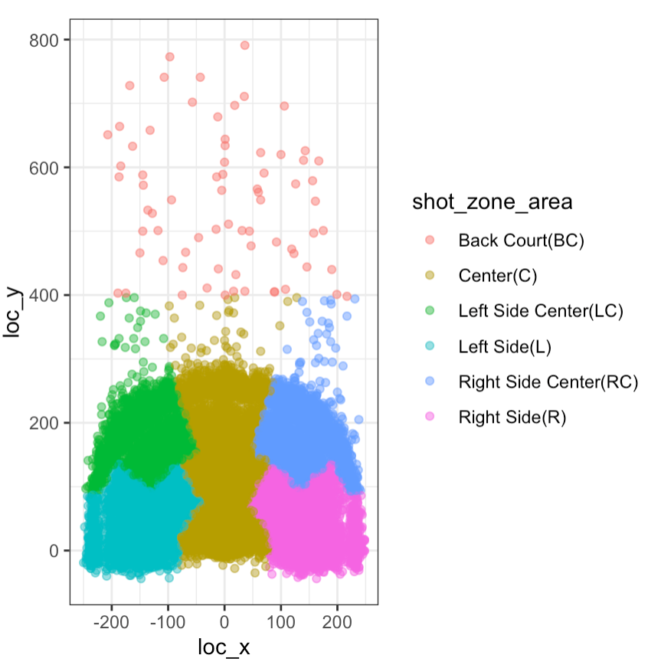
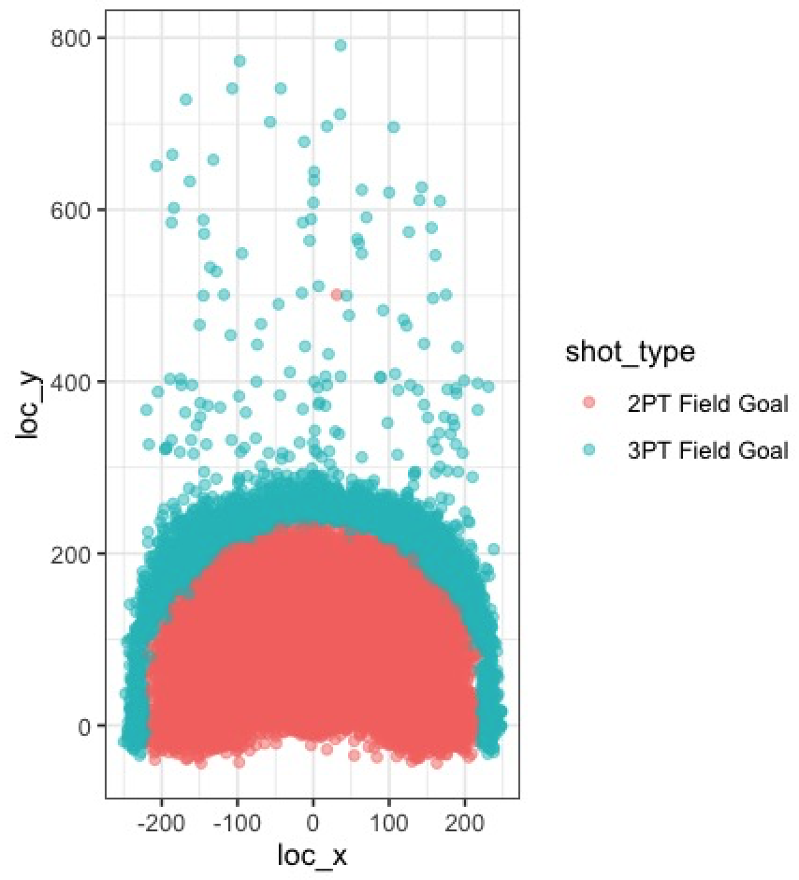
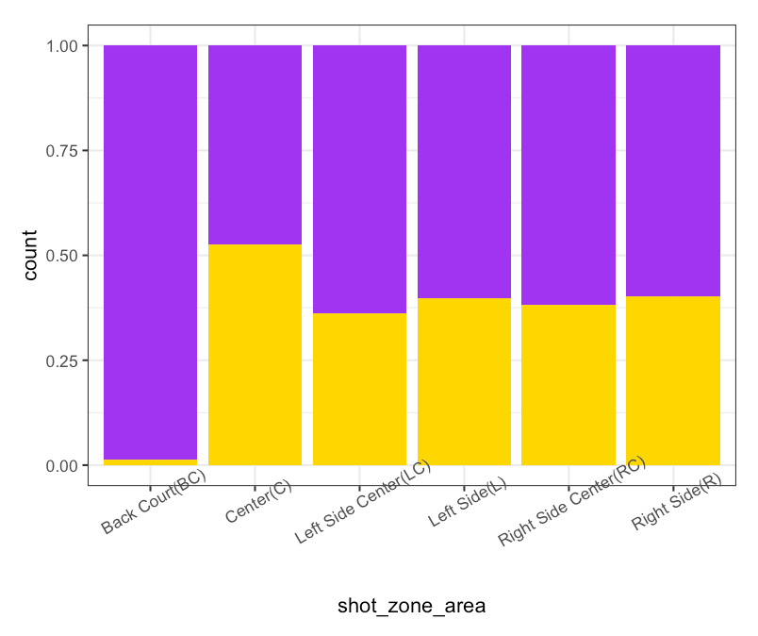
Describing Data
Shot Zone Area
2pt Vs. 3pt

Slide 12
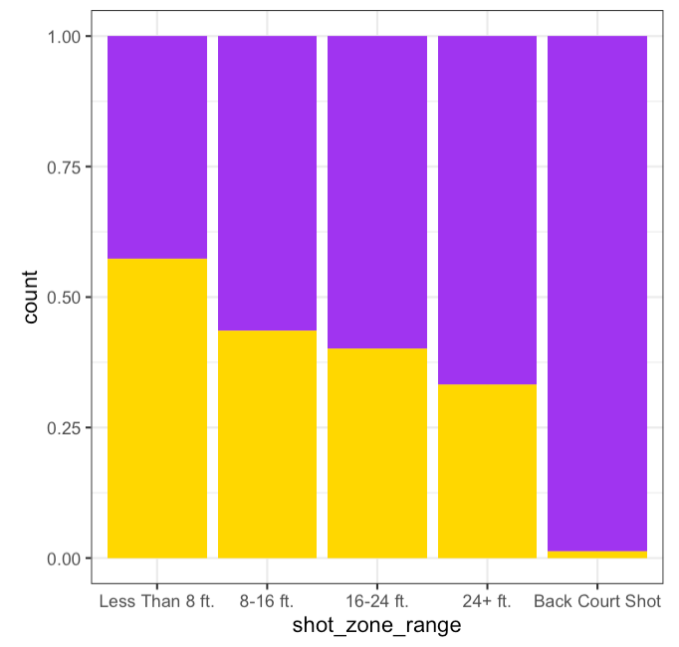
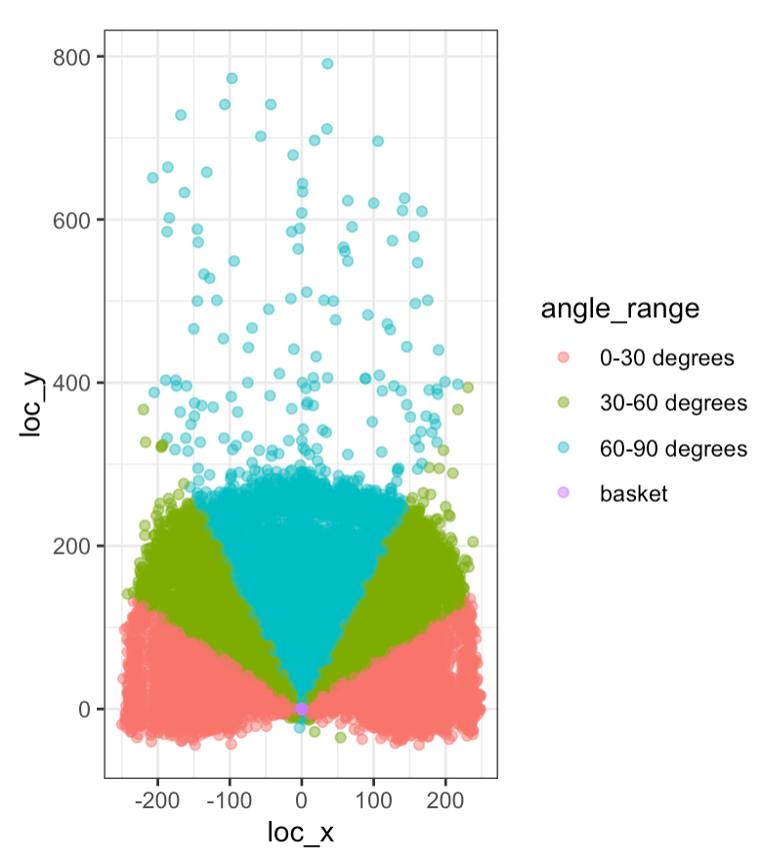
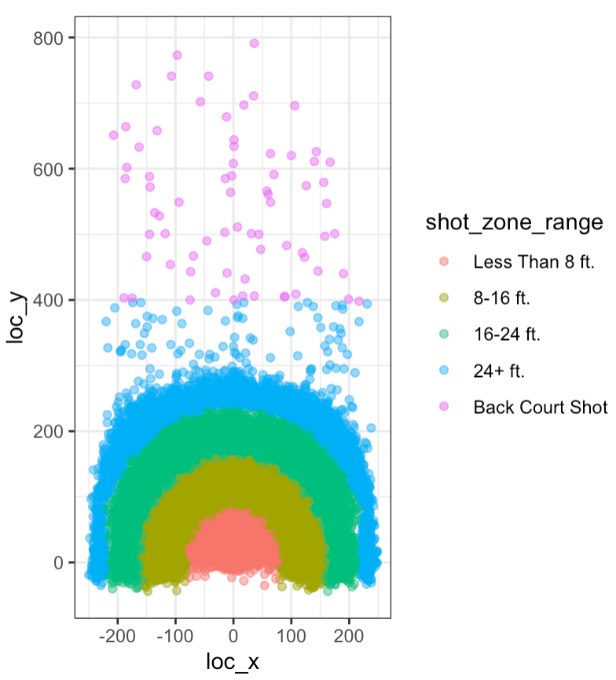
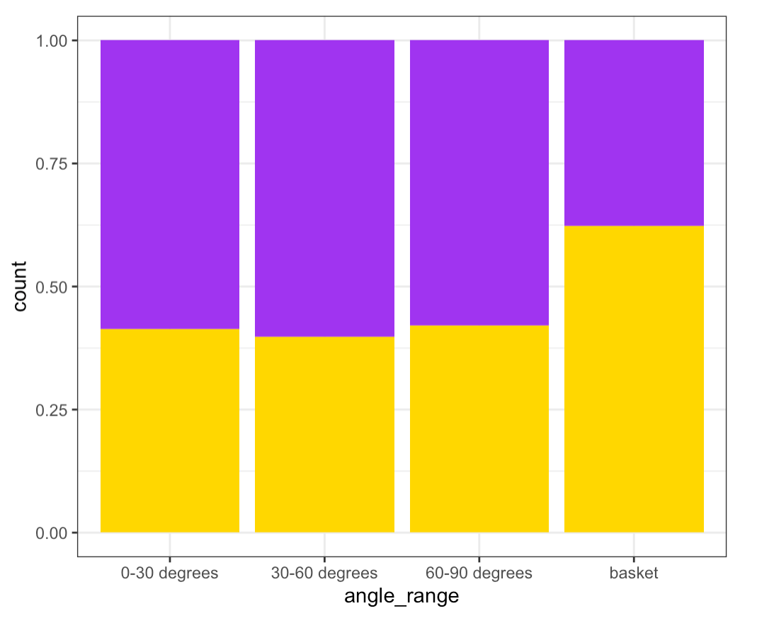
Describing Data
Angle Range
Shot Zone Range

Slide 13
Split Dataset
5140 rows are randomly selected as the test set
(about 20% of the total)
set.seed(666)

Slide 14
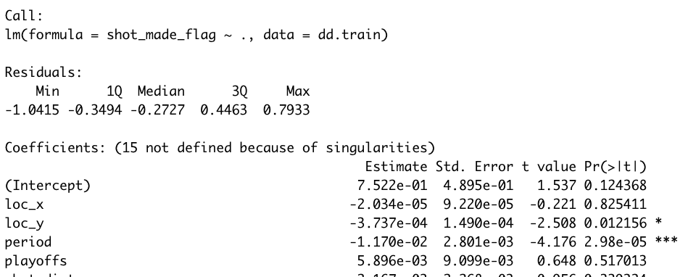
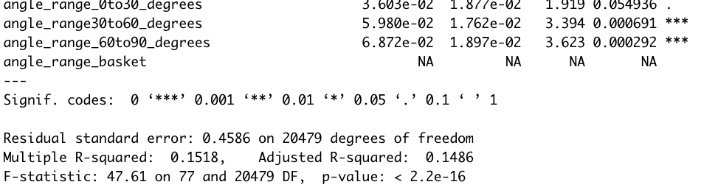
Linear Regression
Intercept:
0.447244
MSE.TRAIN of intercept-only regression: 0.2472289
MSE.TEST of intercept-only regression: 0.2466641
Full model:
93 explanatory variables
MSE.TRAIN of full linear regression: 0.2099965
MSE.TEST of full linear regression: 0.2156048
...

Slide 15
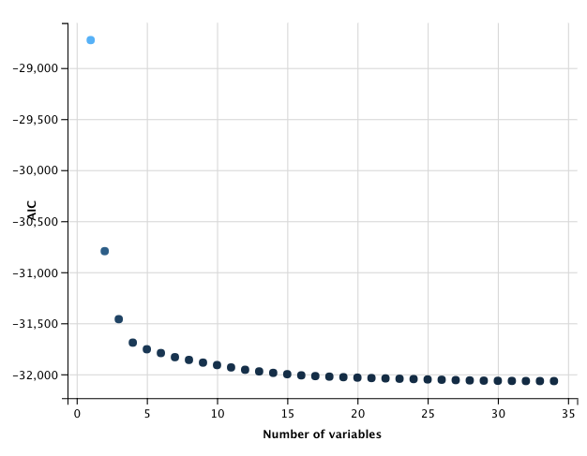
Stepwise Regression: Forward Selection
Initial Model
Intercept only
MSE.TRAIN = 0.2472289
AIC = -28,726
Final Model
33 explanatory variables
MSE.TRAIN= 0.209817
AIC = -32,066
MSE.TEST=0.2160715

Slide 16
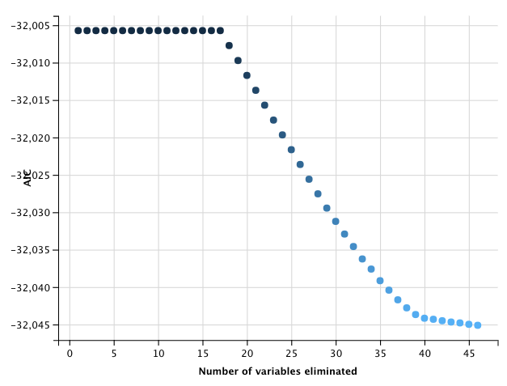
Stepwise Regression: Backward Selection
Initial Model
93 explanatory variables
MSE.TRAIN = 0.2099965
AIC = -32,006
Final Model
45 explanatory variables
MSE.TRAIN = 0.2098895
AIC = -32,045
MSE.TEST = 0.2163887

Slide 17
Two models for penalized regression
Model1:
full model
Model2:
loc_x +loc_y +playoffs + period + shot_distance + time_remaining + home + action_type_Jump_Shot + action_type_Layup_Shot + combined_shot_type_Dunk

Slide 18
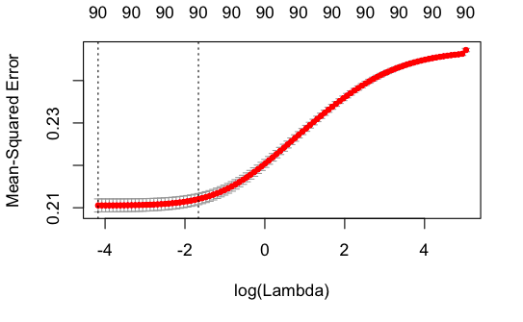
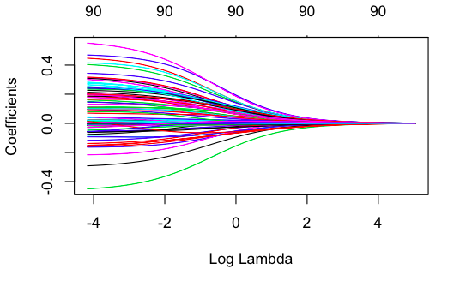
Penalized Regression: Ridge-Model1
MSE.TRAIN = 0.2095502
MSE.TEST = 0.2148982

Slide 19
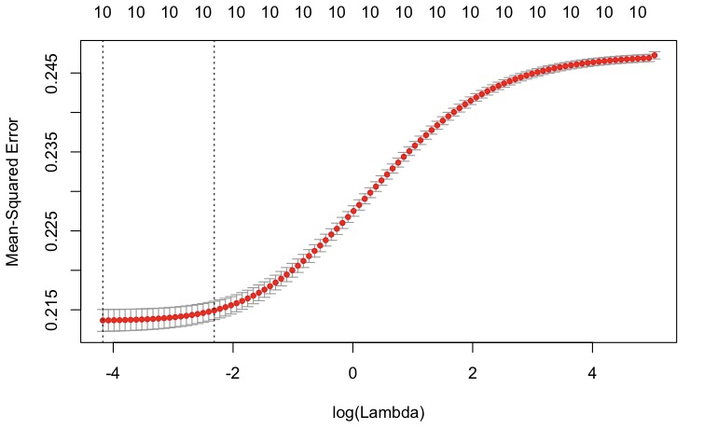
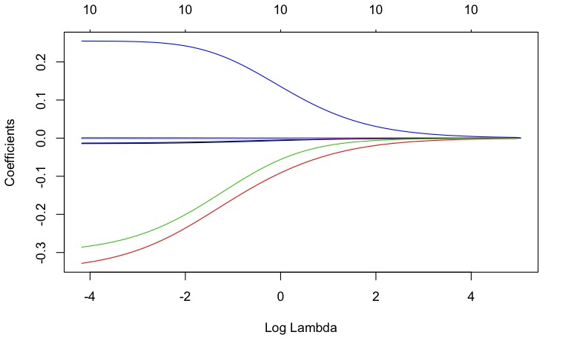
Penalized Regression: Ridge-Model2
MSE.TRAIN = 0.214269
MSE.TEST = 0.2164744

Slide 20
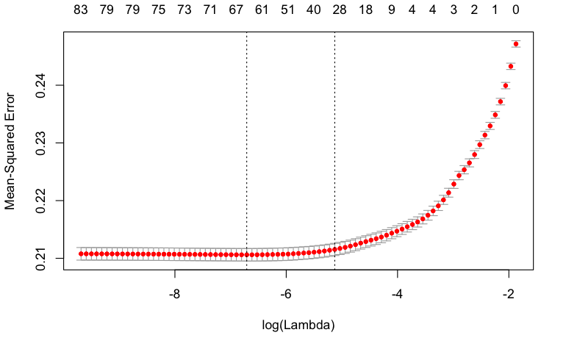
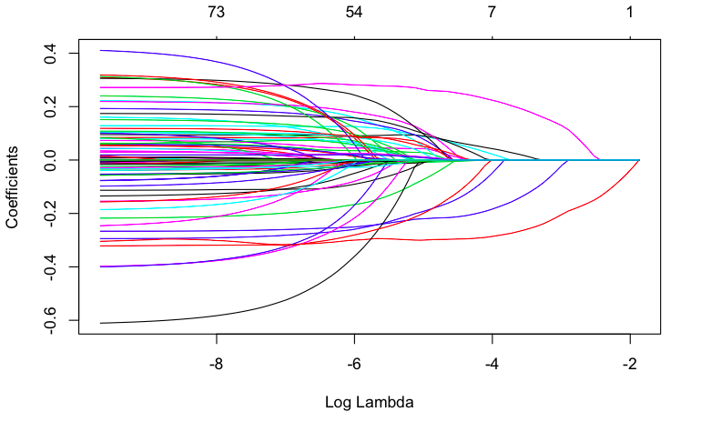
Penalized Regression: Lasso-Model1
MSE.TRAIN = 0.2095722
MSE.TEST = 0.2147144

Slide 21
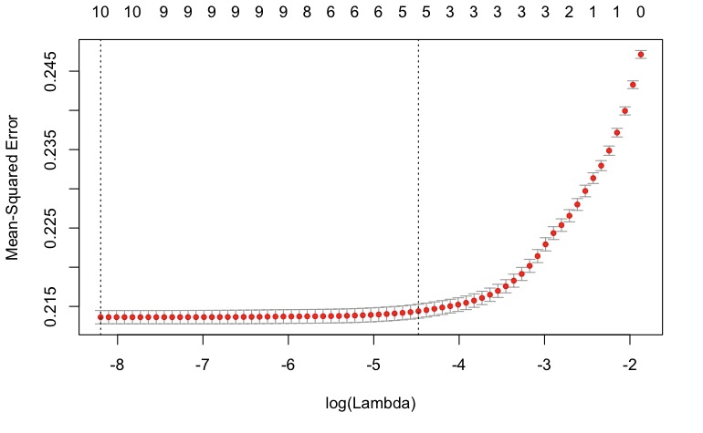
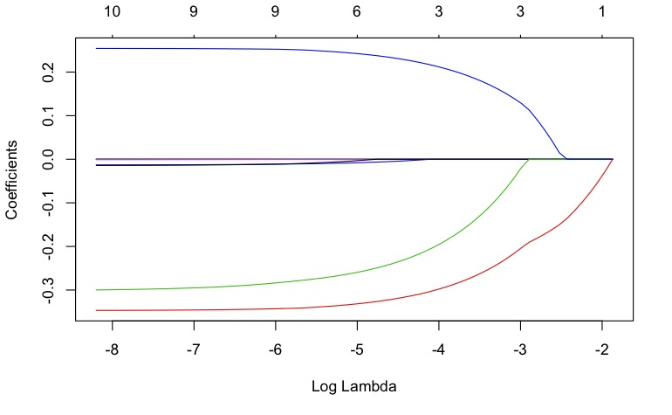
Penalized Regression: Lasso-Model2
MSE.TRAIN = 0.2142151
MSE.TEST = 0.2165744

Slide 22
Two Models for trees, random forest, and boosting
F1: simple random model
f1 <- as.formula(shot_made_flag ~ shot_distance+time_remaining+period+shot_type)
F2: full model
f2 <- as.formula(shot_made_flag ~ .)

Slide 23
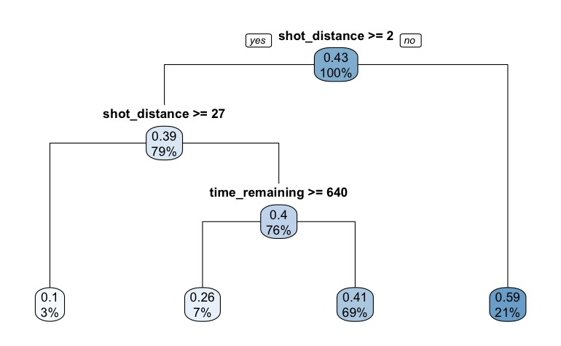
Trees
MSE.TRAIN =0.2343111
MSE.TEST=0.2433927
cp=0.006

Slide 24
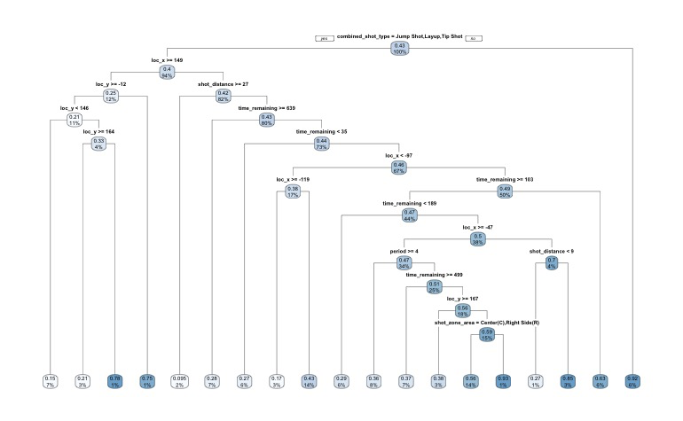
Trees
MSE.TRAIN = 0.1984447
MSE.TEST=0.2660737
cp=0.006

Slide 25
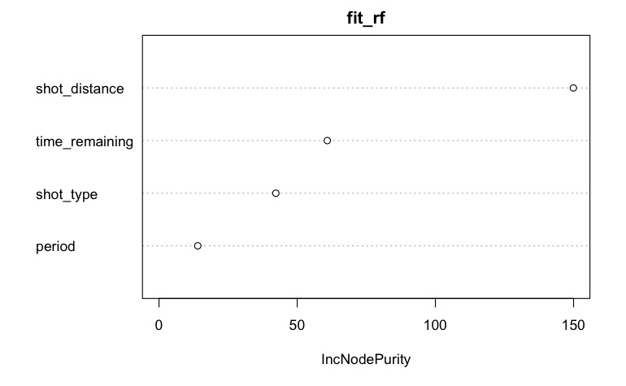
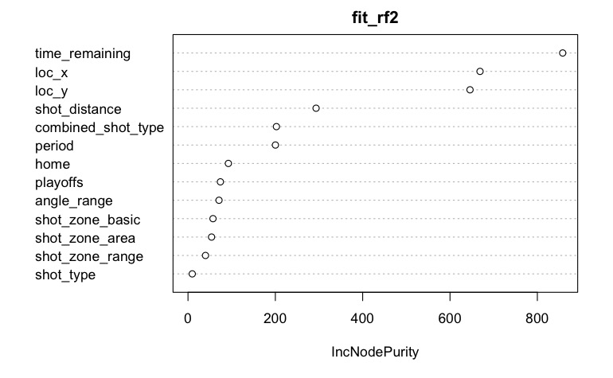
Random Forest
Variable Importance Plot
n.trees=100
MSE.TRAIN =0.2320896
MSE.TEST=0.2361976
MSE.TRAIN =0.1021261
MSE.TEST=0.2361976

Slide 26
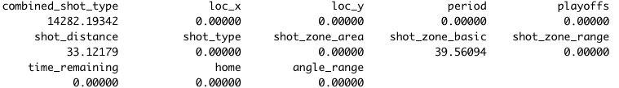
Boosting
n.trees=100
MSE.TRAIN =0.2452347
MSE.TEST=0.2447662
n.trees=100
relative. influence
MSE.TRAIN =0.2444229
MSE.TEST=0.2441502

Slide 27
MSE || The BEST Model
MODEL | MSE.TRAIN | MSE.TEST
Linear Regression | 0.2472289(intercept) 0.2099965(full) | 0.2466641 0.2156048
Forward Selection | 0.209817 | 0.2160715
Backward Selection | 0.2098895 | 0.2163887
Ridge | 0.2095502(full) 0.214269 | 0.2168982 0.2164744
Lasso | 0.2095722(full) 0.2142151 | 0.2147144 0.2165744
Decision Trees | 0.2343111 0.1984447(full) | 0.2433927 0.2660737
Random Forests | 0.2320896 0.1021261(full) | 0.2361976 0.2426312
Boosting | 0.2452347 0.2444229(full) | 0.2447662 0.2441502
Would Kobe Make It or Not?

Slide 28
Challenges
Convert categorical variables to dummies -- a lot of columns to work with
Backward and Forward Selection are so slow to run b/c of too many variables
Random Forests could not run well for bigger trees due to too many dummies
Predicting for future basketball players based on Kobe (retired) due to changes in basketball regulations, conditions, teams, etc.
Lasso and Ridge MSEs are too small for full models
Comparisons between one randomly picked model and full model
Every time we run the entire dataset, it will get different results(MSEs) even we set seed and some graphs showed up at wrong spots when knitting

Slide 29
Summary
After comparing all models for our dataset, we find out the best model is Lasso as it has the lowest MSE test without overfitting.
We are hoping this project would be helpful for basketball players who want to learn from Kobe Bryant and even for analysis of other sports.
Go make a shot!

